Slide 1
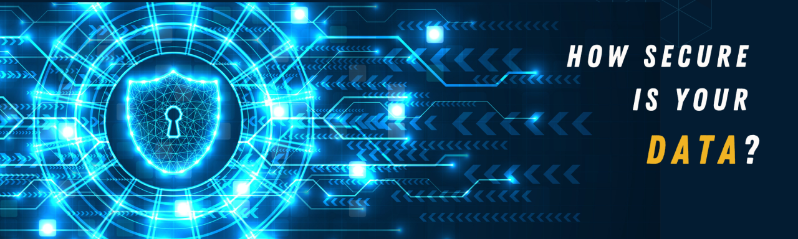

Information Security
Lecture 2
Classical Encryption Techniques
Dr. Muazzam Ali Khan Khattak
Professor
Department of Computer Science
QAU, Islamabad
Email: muazzam.khattak@qau.edu.pk

Slide 2
Symmetric Encryption
Conventional / private-key / single-key
Sender and recipient share a common key
All classical encryption algo use private-key
Only type prior to invention of public-key in 1970’s
Most widely used Encryption
Notes:
Symmetric encryption, also referred to as conventional encryption or single-key encryption, was the only type of encryption in use prior to the development of public-key encryption in the 1970s. It remains by far the most widely used of the two types of encryption. All traditional schemes are symmetric / single key / private-key encryption algorithms, with a single key, used for both encryption and decryption. Since both sender and receiver are equivalent, either can encrypt or decrypt messages using that common key.

Slide 3

Symmetric Cipher Model
Notes:
Detail the five ingredients of the symmetric cipher model, shown in Stallings Figure 2.1:
plaintext - original message
encryption algorithm – performs substitutions/transformations on plaintext
secret key – control exact substitutions/transformations used in encryption algorithm
ciphertext - scrambled message
decryption algorithm – inverse of encryption algorithm

Slide 4
Requirements
Two requirements for secure use of symmetric encryption:
  strong encryption algorithm
  secret key known only to sender / receiver
Mathematically have:
  Y = E_{K}(X)
  X = D_{K}(Y)
Encryption algorithm is known
Implies a secure channel to distribute key
Notes:
We assume that it is impractical to decrypt a message on the basis of the cipher- text plus knowledge of the encryption/decryption algorithm, and do not need to keep the algorithm secret; rather we only need to keep the key secret. This feature of symmetric encryption is what makes it feasible for widespread use. It allows easy distribution of s/w and h/w implementations.
Can take a closer look at the essential elements of a symmetric encryption scheme: mathematically it can be considered a pair of functions with: plaintext X, ciphertext Y, key K, encryption algorithm E_{K}, decryption algorithm D_{K}.

Slide 5
Cryptography and Cryptanalysis
Cryptographic system characterizes by:
  Type of encryption operations used
    Substitution / Transposition / Product
  Number of keys used
    Single-key or Private / Two-key or Public
  The way plaintext is processed
    Block / Stream
Notes:
Cryptographic systems can be characterized along these three independent dimensions.

Slide 6
Cryptanalysis objective is to recover key not just message
General approaches:
  Cryptanalytic attack
  Brute-force attack

Slide 7
Cryptanalytic Attacks
Ciphertext only
  Only know algorithm & ciphertext
Known plaintext
  Know/suspect plaintext & ciphertext
Chosen plaintext
  Select plaintext and obtain ciphertext
Chosen ciphertext
  Select ciphertext and obtain plaintext
Chosen text
  Select plaintext or ciphertext to en/decrypt
Notes:
Stallings Table 2.1 summarizes the various types of cryptanalytic attacks, based on the amount of information known to the cryptanalyst, from least to most. The most difficult problem is presented when all that is available is the ciphertext only. In some cases, not even the encryption algorithm is known, but in general we can assume that the opponent does know the algorithm used for encryption. Then with increasing information have the other attacks. Generally, an encryption algorithm is designed to withstand a known-plaintext attack.

Slide 8
Unconditional and Computational Security
Unconditional Security
  No matter how much computer power or time is available, the cipher cannot be broken since the ciphertext provides insufficient information to uniquely determine the corresponding plaintext
Computational Security
  Given limited computing resources (e.g. time needed for calculations is greater than age of universe), the cipher cannot be broken
Notes:
Two more definitions are worthy of note. An encryption scheme is unconditionally secure if the ciphertext generated by the scheme does not contain enough information to determine uniquely the corresponding plaintext, no matter how much ciphertext is available. An encryption scheme is said to be computationally secure if either the cost of breaking the cipher exceeds the value of the encrypted information, or the time required to break the cipher exceeds the useful lifetime of the information. Unconditional security would be nice, but the only known such cipher is the one-time pad (later).
For all reasonable encryption algorithms, we have to assume computational security where it either takes too long, or is too expensive, to bother breaking the cipher.

Slide 9
Brute Force Search
Always possible to simply try every key
Most basic attack, proportional to key size
Assume either know / recognise plaintext
Key Size (bits) | Number of Alternative Keys | Time required at 1 decryption/µs | Time required at 10⁶ decryptions/µs
32 | 2³² = 4.3 × 10⁹ | 2³¹ µs = 35.8 minutes | 2.15 milliseconds
56 | 2⁵⁶ = 7.2 × 10¹⁶ | 2⁵⁵ µs = 1142 years | 10.01 hours
128 | 2¹²⁸ = 3.4 × 10³⁸ | 2¹²⁷ µs = 5.4 × 10²⁴ years | 5.4 × 10¹⁸ years
168 | 2¹⁶⁸ = 3.7 × 10⁵⁰ | 2¹⁶⁷ µs = 5.9 × 10³⁶ years | 5.9 × 10³⁰ years
26 characters (permutation) | 26! = 4 × 10²⁶ | 2 × 10²⁶ µs = 6.4 × 10¹² years | 6.4 × 10⁶ years
Notes:
A brute-force attack involves trying every possible key until an intelligible translation of the ciphertext into plaintext is obtained. On average, half of all possible keys must be tried to achieve success. Stallings Table 2.2 shows how much time is required to conduct a brute-force attack, for various common key sizes (DES is 56, AES is 128, Triple-DES is 168, plus general mono-alphabetic cipher), where either a single system or a million parallel systems, are used.

Slide 10

Classical Substitution Ciphers
Letters in plaintext are replaced by
  other letters
  by numbers
  Symbols
If plaintext is viewed as a sequence of bits, then
  substitution involves
Replacing plaintext bit patterns with ciphertext bit patterns
Substitution
Notes:
In this section and the next, we examine a sampling of what might be called classical encryption techniques. A study of these techniques enables us to illustrate the basic approaches to symmetric encryption used today and the types of cryptanalytic attacks that must be anticipated. The two basic building blocks of all encryption technique are substitution and transposition. We examine these in the next two sections. Finally, we discuss a system that combine both substitution and transposition.

Slide 11
Caesar Cipher
Earliest known substitution cipher By Julius Caesar
First attested use in military affairs
Replaces each letter by 3rd letter on
Example
  meet me after the toga party
  PHHW PH DIWHU WKH WRJD SDUWB
Transformation
  a b c d e f g h i j k l m n o p q r s t u v w x y z
  D E F G H I J K L M N O P Q R S T U V W X Y Z A B C
Mathematically give each letter a number
  a b c d e f g h i j k l m n o p q r s t u v w x y z
  0 1 2 3 4 5 6 7 8 9 10 11 12 13 14 15 16 17 18 19 20 21 22 23 24 25
Caesar cipher formula
  c = E(p) = (p + k) mod (26)
  p = D(c) = (c – k) mod (26)
Notes:
Substitution ciphers form the first of the fundamental building blocks. The core idea is to replace one basic unit (letter/byte) with another. Whilst the early Greeks described several substitution ciphers, the first attested use in military affairs of one was by Julius Caesar, described by him in Gallic Wars (cf. Kahn pp83-84). Still call any cipher using a simple letter shift a caesar cipher, not just those with shift 3.

Slide 12
Cryptanalysis of Caesar Cipher
Only have 26 possible ciphers
  A maps to A,B,..Z
Could simply try each in turn
A brute force search
Given ciphertext, just try all shifts of letters
Do need to recognize when have plaintext
e.g. break ciphertext "GCUA VQ DTGCM"
Notes:
With a caesar cipher, there are only 26 possible keys, of which only 25 are of any use, since mapping A to A etc doesn't really obscure the message! Note this basic rule of cryptanalysis "check to ensure the cipher operator hasn't goofed and sent a plaintext message by mistake"!
Can try each of the keys (shifts) in turn, until can recognise the original message. See Stallings Fig 2.3 for example of search.
Note: as mentioned before, do need to be able to recognise when have an original message (ie is it English or whatever). Usually easy for humans, hard for computers. Though if using say compressed data could be much harder.
Example "GCUA VQ DTGCM" when broken gives "easy to break", with a shift of 2 (key C).

Slide 13
Monoalphabetic Cipher
Rather than just shifting the alphabet
Could shuffle (jumble) the letters arbitrarily
Each plaintext letter maps to a different random ciphertext letter
Hence key is 26 letters long
With so many keys, might think is secure
But would be !!!WRONG!!!
Problem is language characteristics
Notes:
With only 25 possible keys, the Caesar cipher is far from secure. A dramatic increase in the key space can be achieved by allowing an arbitrary substitution, where the translation alphabet can be any permutation of the 26 alphabetic characters.
See example translation alphabet, and an encrypted message using it.

Slide 14
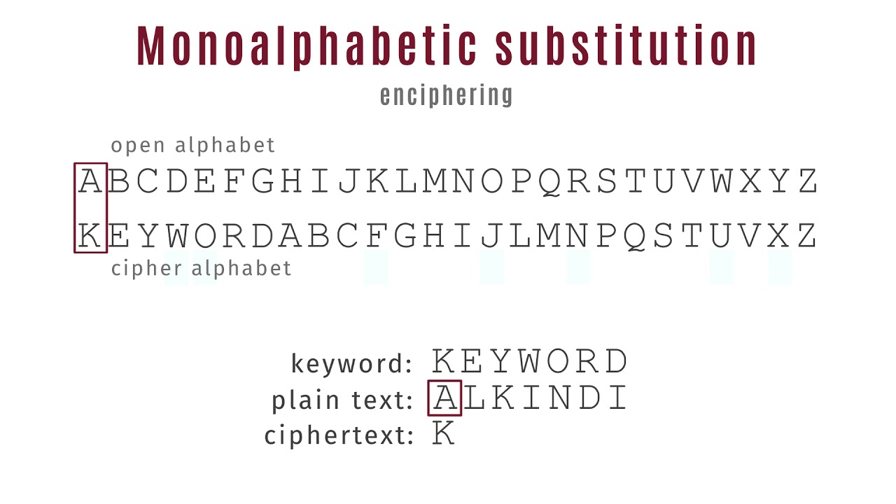


Slide 15
Playfair Cipher
A 5X5 matrix of letters based on a keyword
Fill in letters of keyword (minus duplicates)
Fill rest of matrix with other letters
e.g. using the keyword MONARCHY
M | O | N | A | R
C | H | Y | B | D
E | F | G | I/J | K
L | P | Q | S | T
U | V | W | X | Z
Notes:
The best-known multiple-letter encryption cipher is the Playfair, which treats digrams in the plaintext as single units and translates these units into ciphertext digrams. The Playfair algorithm is based on the use of a 5x5 matrix of letters constructed using a keyword. The rules for filling in this 5x5 matrix are: L to R, top to bottom, first with keyword after duplicate letters have been removed, and then with the remain letters, with I/J used as a single letter. This example comes from Dorothy Sayer's book "Have His Carcase", in which Lord Peter Wimsey solves it, and describes the use of a probably word attack.

Slide 16
Encrypting and Decrypting
Plaintext is encrypted two letters at a time
  if a pair is a repeated letter, insert filler like ‘X’
  if both letters fall in the same row, replace each with letter to right (wrapping back to start from end)
  if both letters fall in the same column, replace each with the letter below it (again wrapping to top from bottom)
  Otherwise, each letter is replaced by the letter in the same row and in the column of the other letter of the pair
Notes:
Plaintext is encrypted two letters at a time,according to the rules as shown. Note how you wrap from right side back to left, or from bottom back to top.
if a pair is a repeated letter, insert a filler like 'X', eg. "balloon" encrypts as "ba lx lo on"
if both letters fall in the same row, replace each with letter to right (wrapping back to start from end), eg. “ar" encrypts as "RM"
if both letters fall in the same column, replace each with the letter below it (again wrapping to top from bottom), eg. “mu" encrypts to "CM"
otherwise each letter is replaced by the one in its row in the column of the other letter of the pair, eg. “hs" encrypts to "BP", and “ea" to "IM" or "JM" (as desired)
Decrypting of course works exactly in reverse. Can see this by working the example pairs shown, backwards.

Slide 17
Security much improved over monoalphabetic
Since have 26 x 26 = 676 diagrams
It was widely used for many years
  eg. by US & British military in WW1 & WW2

Slide 18
Polyalphabetic Ciphers
Polyalphabetic substitution ciphers
Improve security using multiple cipher alphabets
Make cryptanalysis harder with more alphabets to guess and flatter frequency distribution
Use a key to select which alphabet is used for each letter of the message
Use each alphabet in turn
Repeat from start after end of key is reached
https://www.youtube.com/watch?v=cRX_8GaJ2xE
Notes:
One approach to reducing the "spikyness" of natural language text is used the Playfair cipher which encrypts more than one letter at once. We now consider the other alternative, using multiple cipher alphabets in turn. This gives the attacker more work, since many alphabets need to be guessed, and because the frequency distribution is more complex, since the same plaintext letter could be replaced by several ciphertext letters, depending on which alphabet is used. The general name for this approach is a polyalphabetic substitution cipher. All these techniques have the following features in common:
A set of related monoalphabetic substitution rules is used.
2. A key determines which particular rule is chosen for a given transformation.

Slide 19
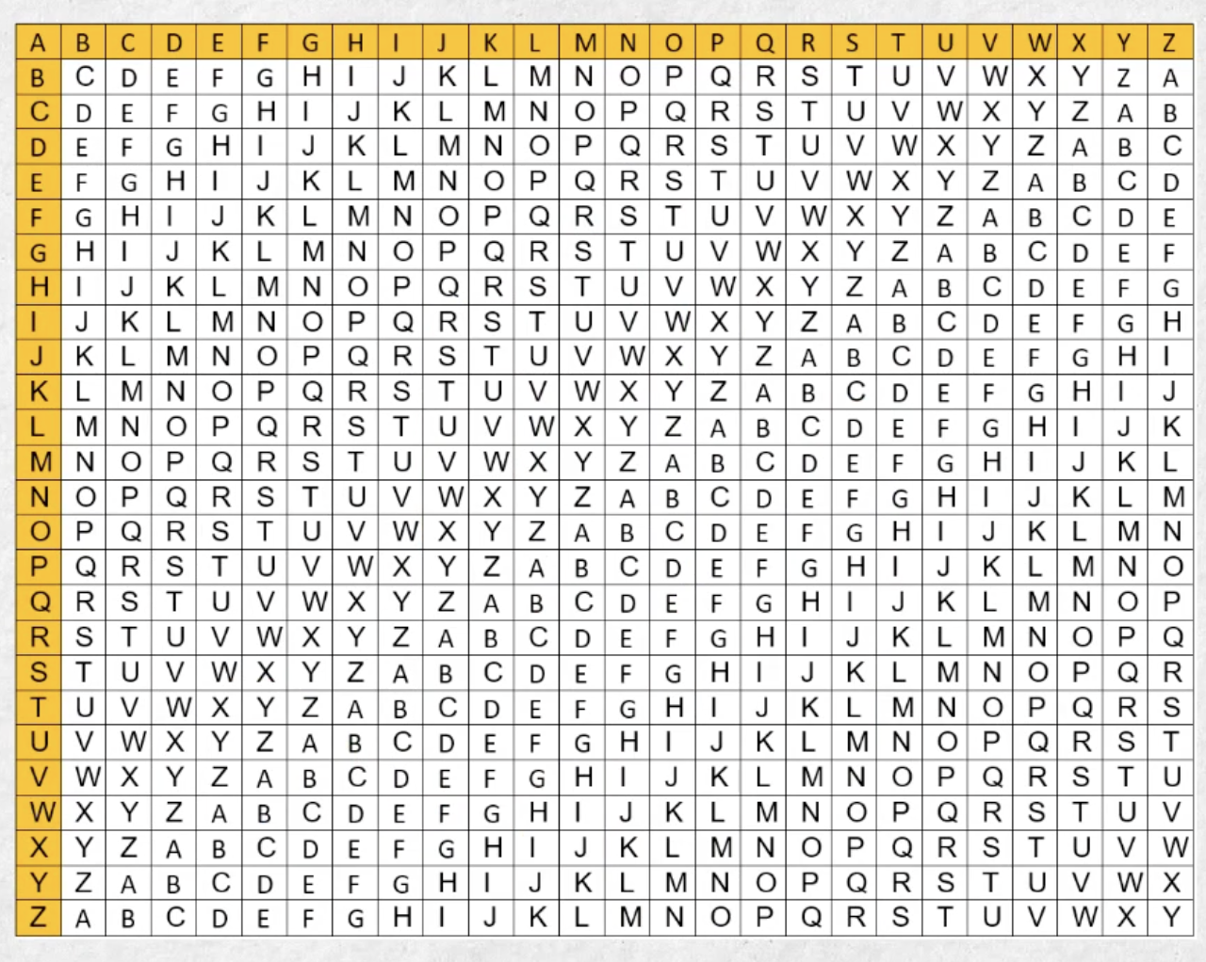
Table Construction

Slide 20
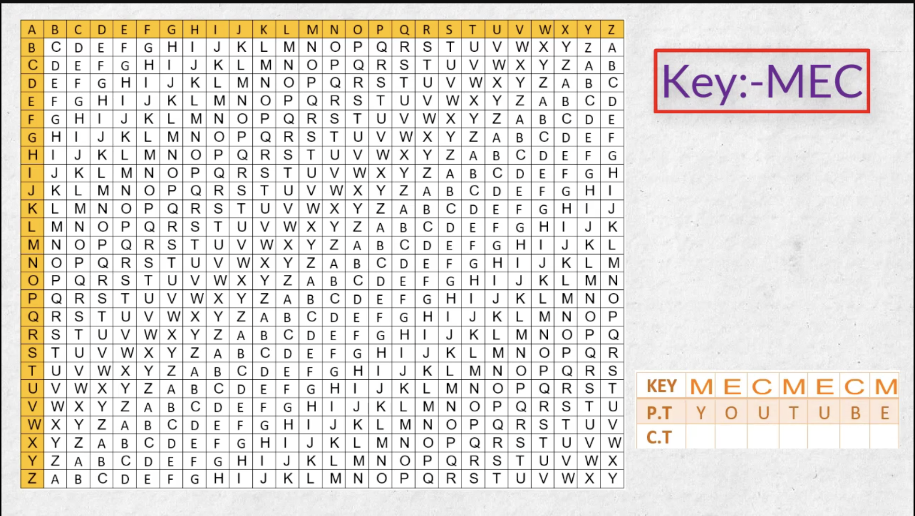
Key and Plain Text

Slide 21
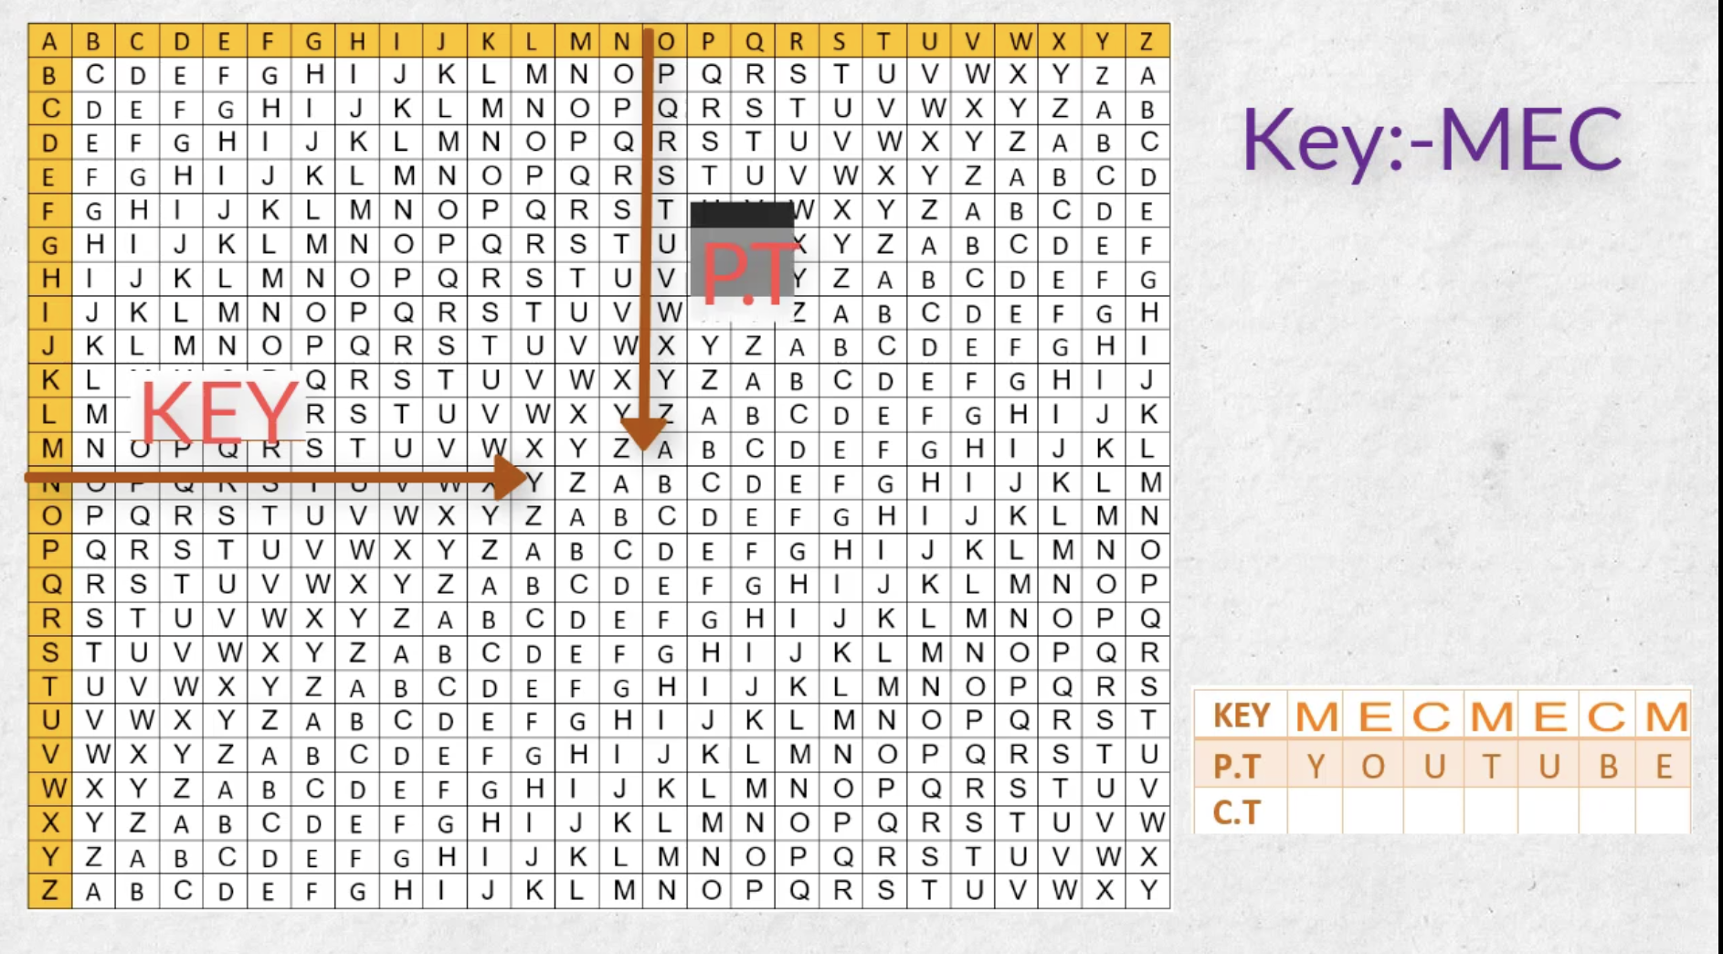

Slide 22
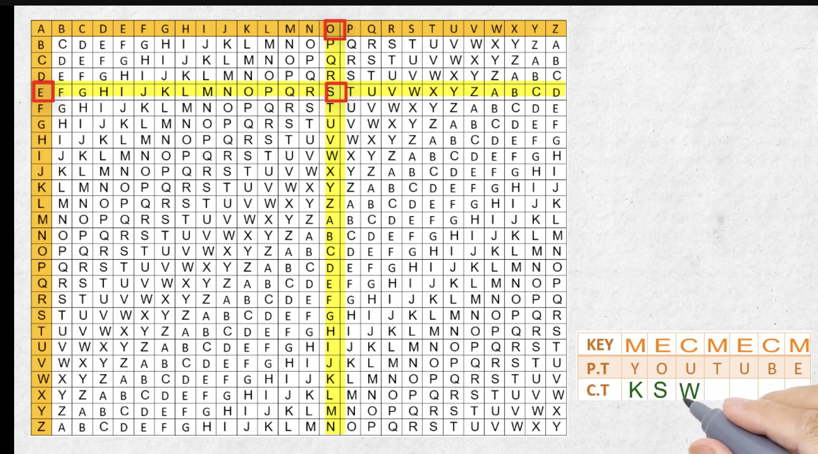

Slide 23
Vigenère Cipher
Simplest polyalphabetic substitution cipher
Effectively multiple caesar ciphers
Key is multiple letters long K = k₁ k₂ ... k_{d}
i^{th} letter specifies i^{th} alphabet to use
Use each alphabet in turn
Repeat from start after d letters in message
Decryption simply works in reverse
https://www.youtube.com/watch?v=SkJcmCaHqS0
Notes:
The best known, and one of the simplest, such algorithms is referred to as the Vigenère cipher, where the set of related monoalphabetic substitution rules consists of the 26 Caesar ciphers, with shifts of 0 through 25. Each cipher is denoted by a key letter, which is the ciphertext letter that substitutes for the plaintext letter ‘a’, and which are each used in turn, as shown next.

Slide 24
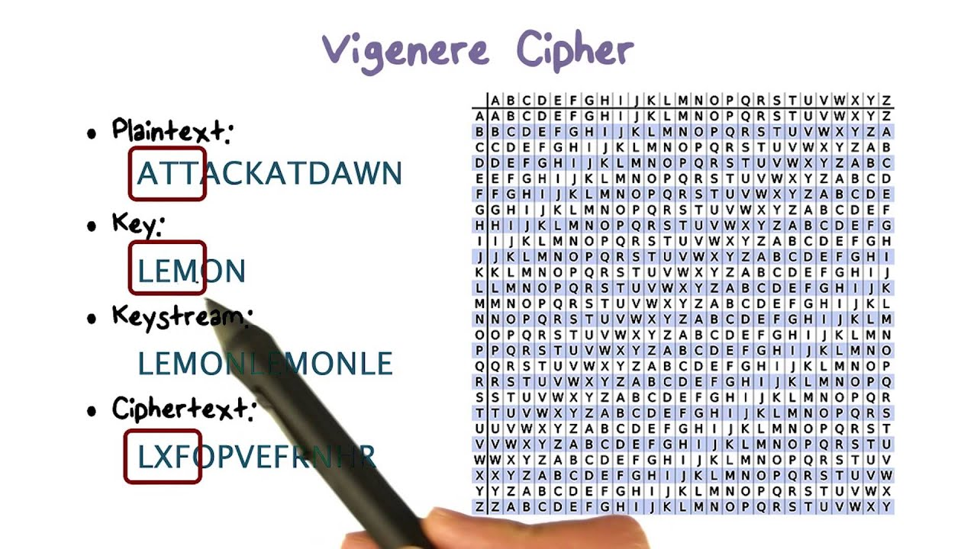
Vigenere Cipher

Slide 25
Example of Vigenère Cipher
Write the plaintext out
Write the keyword repeated above it
Use each key letter as a caesar cipher key
Encrypt the corresponding plaintext letter
eg using keyword deceptive
  key: deceptivedeceptivedeceptive
  plaintext: wearediscoveredsaveyourself
  ciphertext:ZICVTWQNGRZGVTWAVZHCQYGLMGJ
Notes:
Discuss this simple example from text Stallings section 2.2.

Slide 26
Security of Vigenère Ciphers
Have different ciphertext letters for each plaintext letter
Hence letter frequencies are obscured
Need to determine number of alphabets, since then can attack each
Notes:
The Vigenère & related polyalphabetic ciphers still do not completely obscure the underlying language characteristics.
The key to breaking them was to identify the number of translation alphabets, and then attack each separately.

Slide 27
Autokey Cipher
Ideally want a key as long as the message
Vigenère proposed the autokey cipher
With keyword is prefixed to message as key
Knowing keyword can recover the first few letters
Still have frequency characteristics to attack
eg. given key deceptive
  key: deceptivewearediscoveredsav
  plaintext: wearediscoveredsaveyourself
  ciphertext:ZICVTWQNGKZEIIGASXSTSLVVWLA
  https://www.youtube.com/watch?v=JsUHsrXl2cw
Notes:
Taking the polyalphabetic idea to the extreme, want as many different translation alphabets as letters in the message being sent. One way of doing this with a smallish key, is to use the Autokey cipher.
The example uses the keyword "DECEPTIVE" prefixed to as much of the message "WEAREDISCOVEREDSAV" as is needed. When deciphering, recover the first 9 letters using the keyword "DECEPTIVE". Then instead of repeating the keyword, start using the recovered letters from the message "WEAREDISC". As recover more letters, have more of key to recover later letters.
Problem is that the same language characteristics are used by the key as the message. ie. a key of 'E' will be used more often than a 'T' etc hence an 'E' encrypted with a key of 'E' occurs with probability (0.1275)2 = 0.01663, about twice as often as a 'T' encrypted with a key of 'T' have to use a larger frequency table, but it exists given sufficient ciphertext this can be broken.

Slide 28
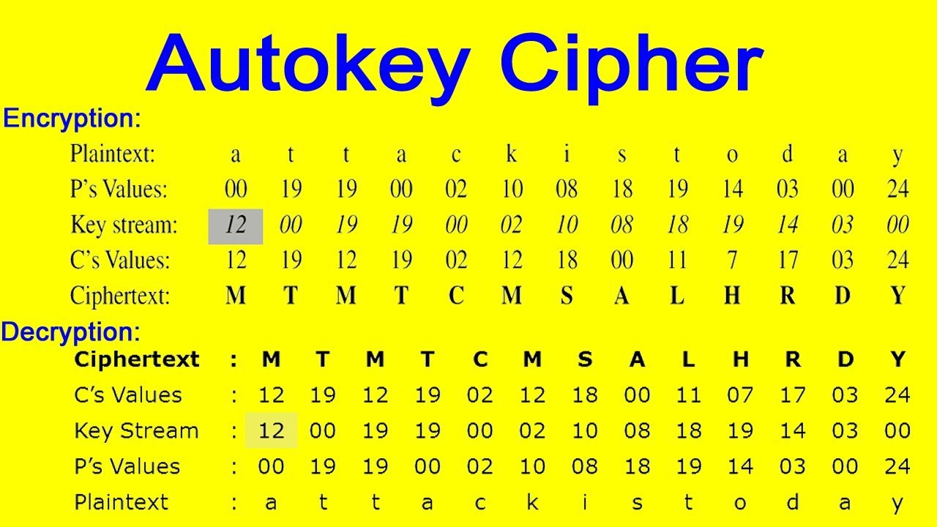
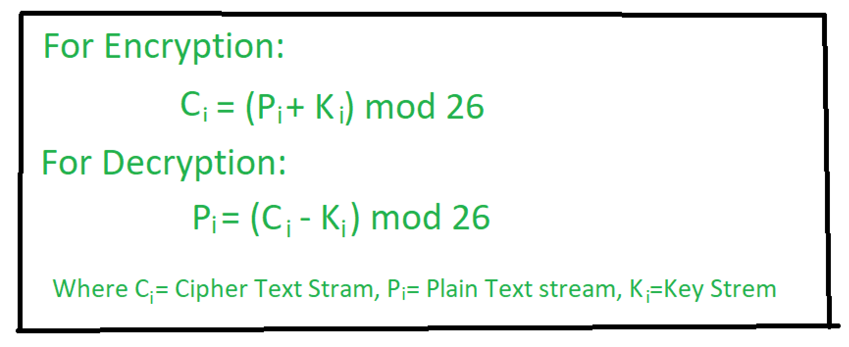
Autokey Cipher

Slide 29
One-Time Pad
A key as long as the message is used
It makes the Cipher more secure.
Its unbreakable since ciphertext bears no relationship to the plaintext
For any plaintext & ciphertext there exists a key mapping one to other
It can only use the key once though
Problems in generation & safe distribution of key
https://www.youtube.com/watch?v=vEbaF1jmbcM
Notes:
The One-Time Pad is an evolution of the Vernham cipher, which was invented by Gilbert Vernham in 1918, and used a long tape of random letters to encrypt the message. An Army Signal Corp officer, Joseph Mauborgne, proposed an improvement using a random key that was truly as long as the message, with no repetitions, which thus totally obscures the original message. It produces random output that bears no statistical relationship to the plaintext. Because the ciphertext contains no information whatsoever about the plaintext, there is simply no way to break the code, since any plaintext can be mapped to any ciphertext given some key.
The one-time pad offers complete security but, in practice, has two fundamental difficulties:
There is the practical problem of making large quantities of random keys.
2. And the problem of key distribution and protection, where for every message to be sent, a key of equal length is needed by both sender and receiver.
Because of these difficulties, the one-time pad is of limited utility, and is useful primarily for low-bandwidth channels requiring very high security.

Slide 30
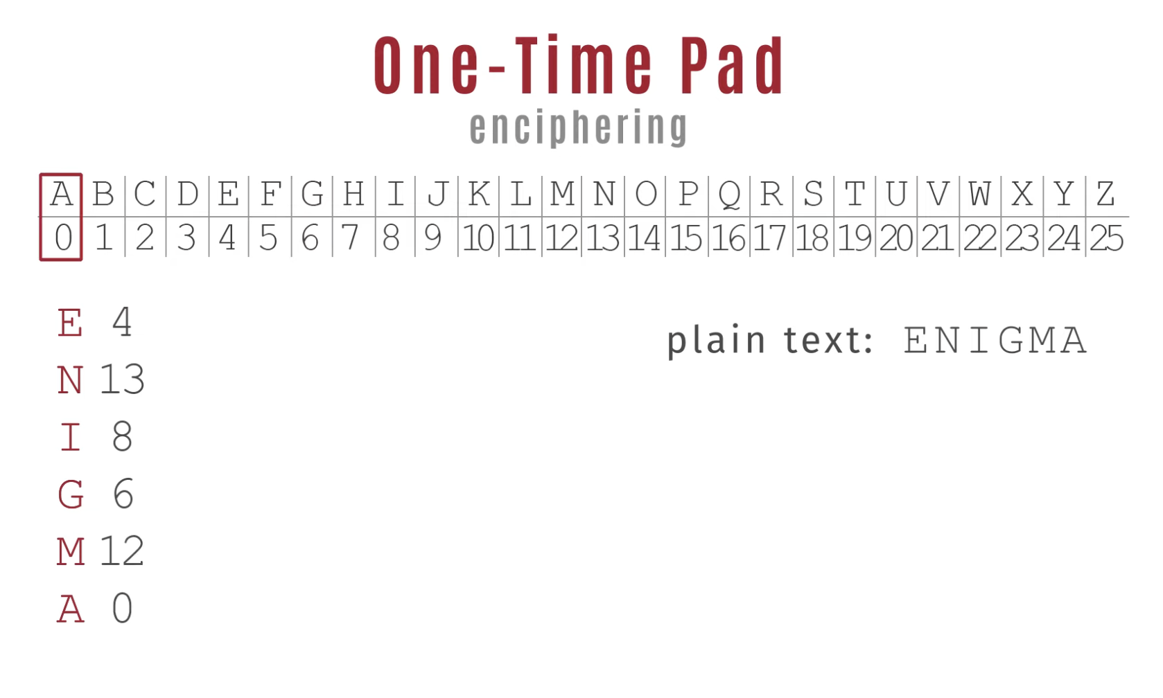

Slide 31
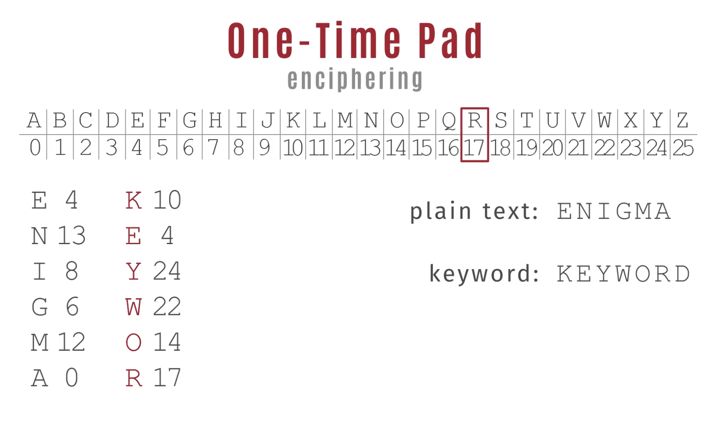

Slide 32
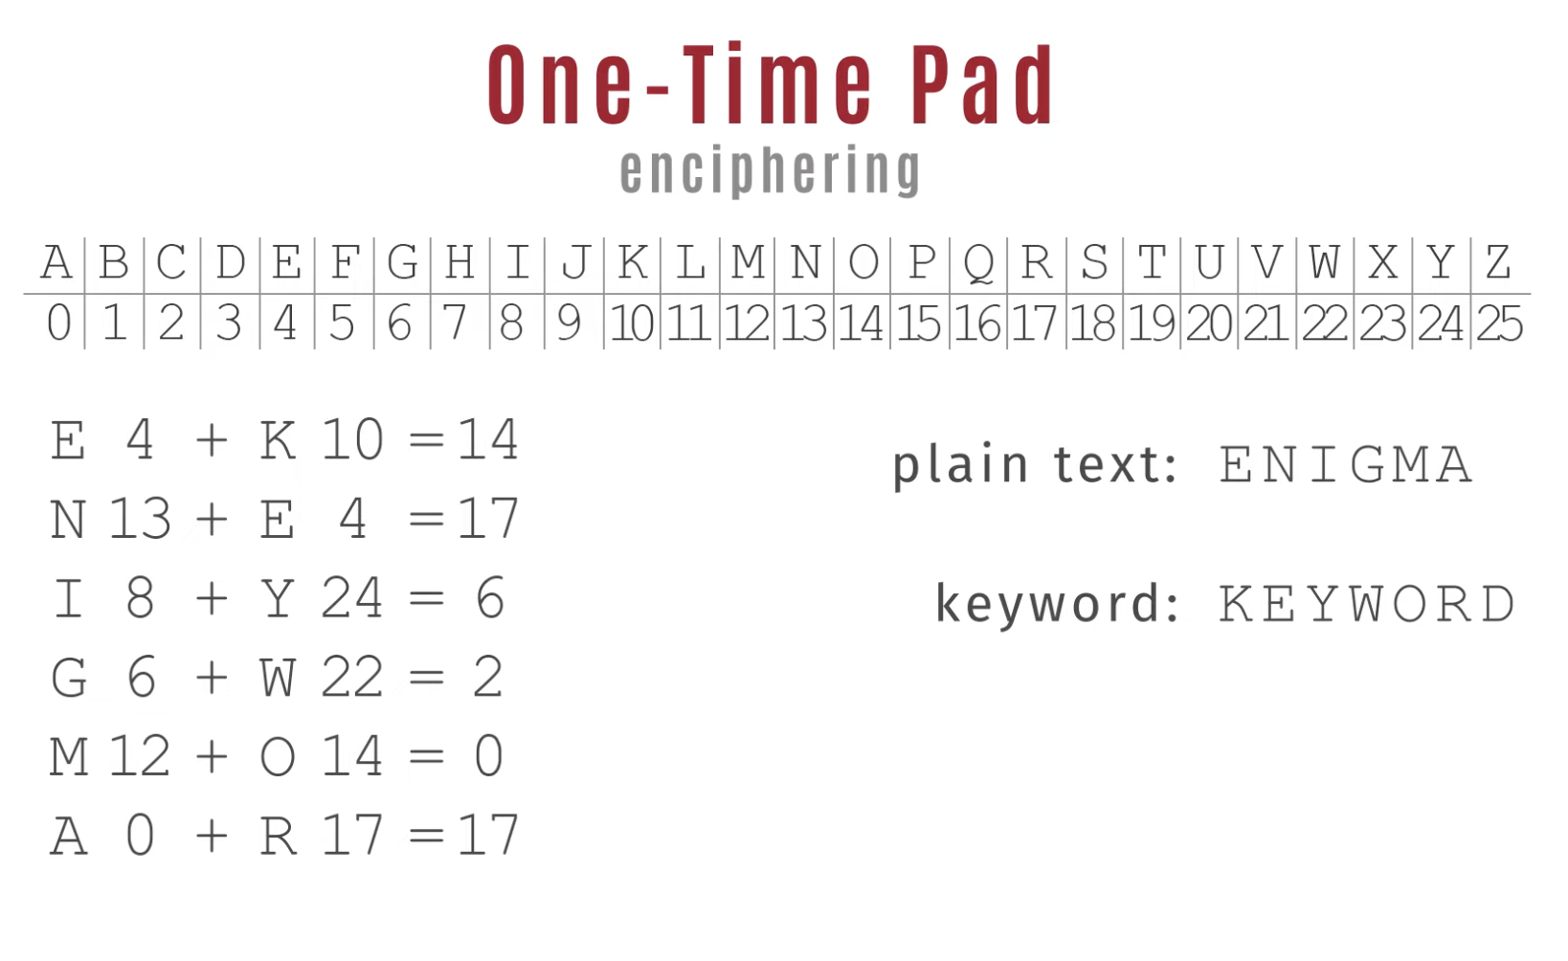

Slide 33
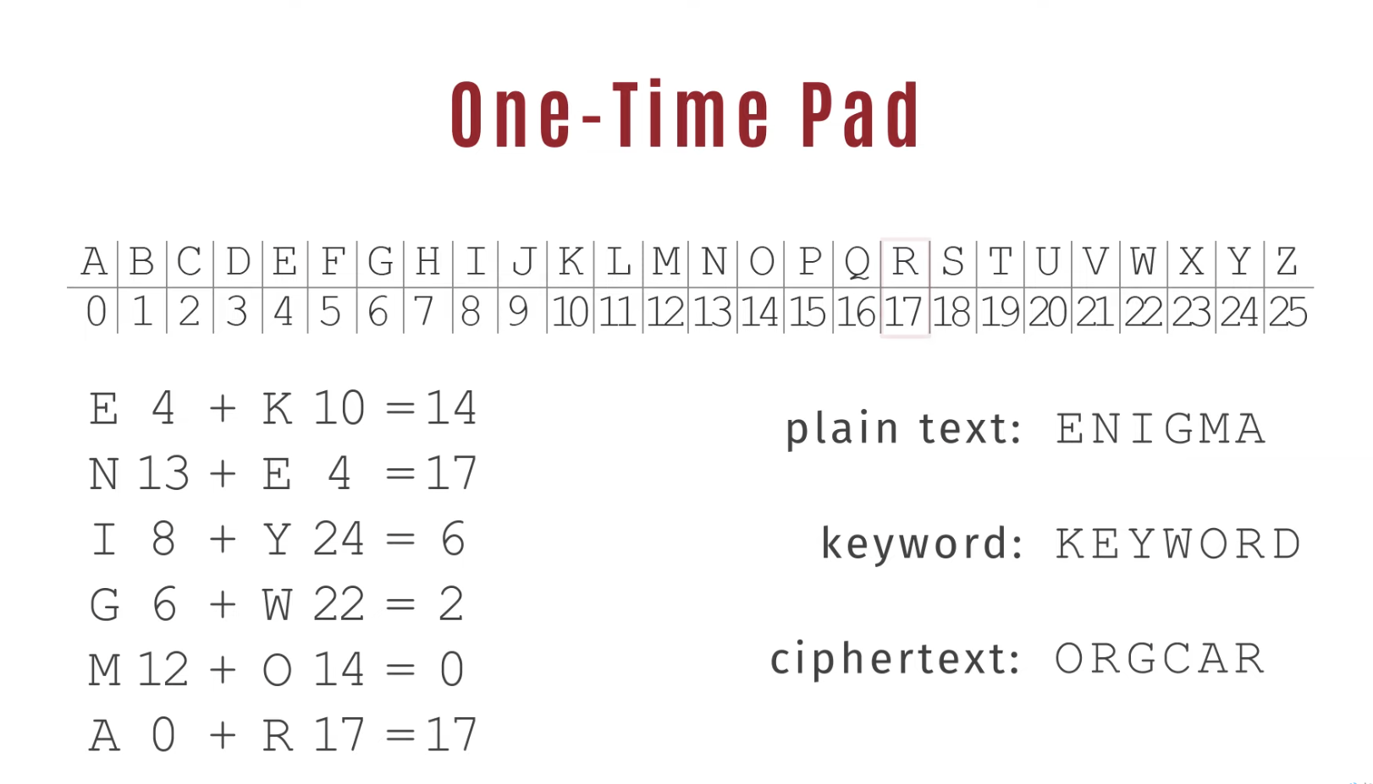
One-Time Pad

Slide 34
Transposition Ciphers
Classical transposition or permutation ciphers
Hide the message by rearranging the letter order without altering actual letters
Write message letters out diagonally over a number of rows then read off cipher row by row
  eg. write message out as:
  m e m a t r h t g p r y
  e t e f e t e o a a t
  giving ciphertext
  MEMATRHTGPRYETEFETEOAAT
  https://www.youtube.com/watch?v=bcyUJK1BvHw
Notes:
All the techniques examined so far involve the substitution of a ciphertext symbol for a plaintext symbol. A very different kind of mapping is achieved by performing some sort of permutation on the plaintext letters. This technique is referred to as a transposition cipher, and form the second basic building block of ciphers. The core idea is to rearrange the order of basic units (letters/bytes/bits) without altering their actual values.

Slide 35
Row Transposition Ciphers
More complex transposition
Write letters of message in rows over a specified number of columns
Then reorder the columns according to key
  Key: 1 2 3 4 5 6 7
  Plaintext: a t t a c k p
  o s t p o n e
  d u n t i l t
  w o a m x y z
  Ciphertext: TTNAAPTMTSUOAODWCOIXKNLYPETZ
  Write row by row, read column by column after reordering
  3 4 1 2 5 6 7 t a a t c k p
  t p o s o n e
  n t d u i l t
  a m w o x y z
Reorder
Notes:
A more complex transposition cipher is to write the message in a rectangle, row by row, and read the message off shuffling the order of the columns in each row.
A pure transposition cipher is easily recognized because it has the same letter frequencies as the original plaintext. For the type of columnar transposition just shown, cryptanalysis is fairly straightforward and involves laying out the ciphertext in a matrix and playing around with column positions. Digram and trigram frequency tables can be useful.

Slide 36
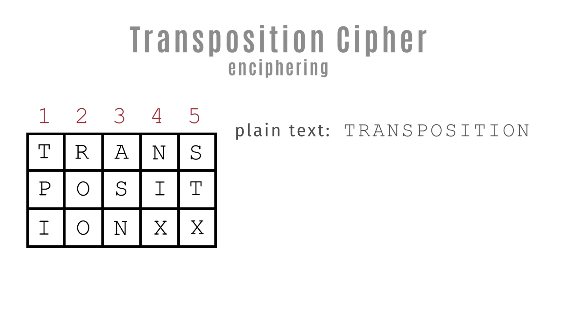

Slide 37
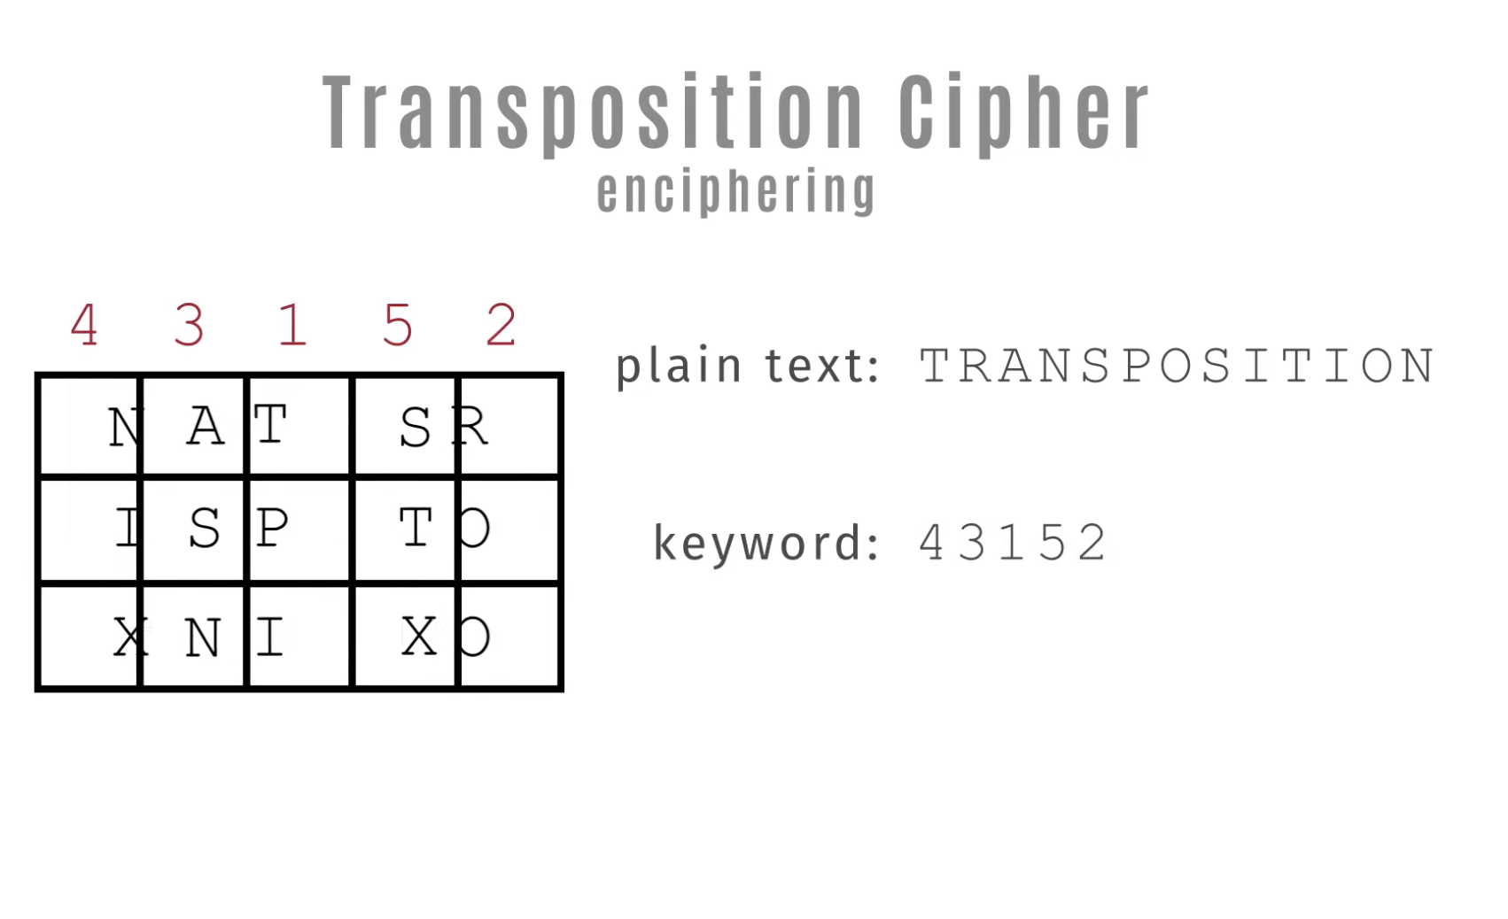

Slide 38
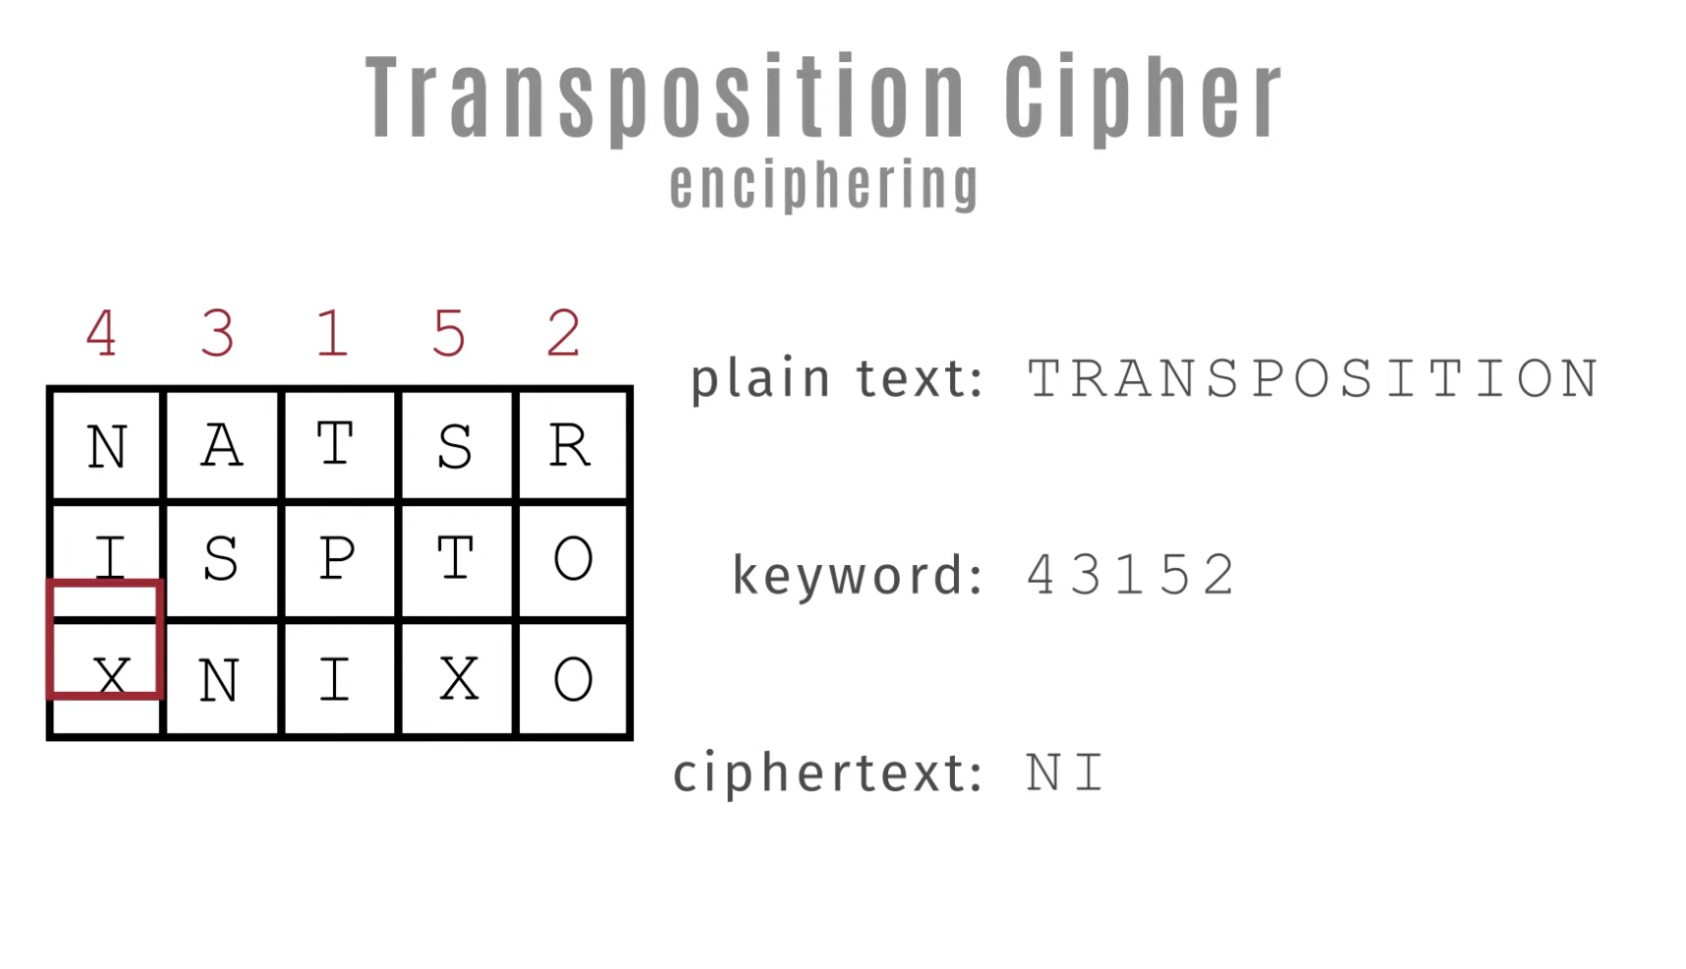

Slide 39
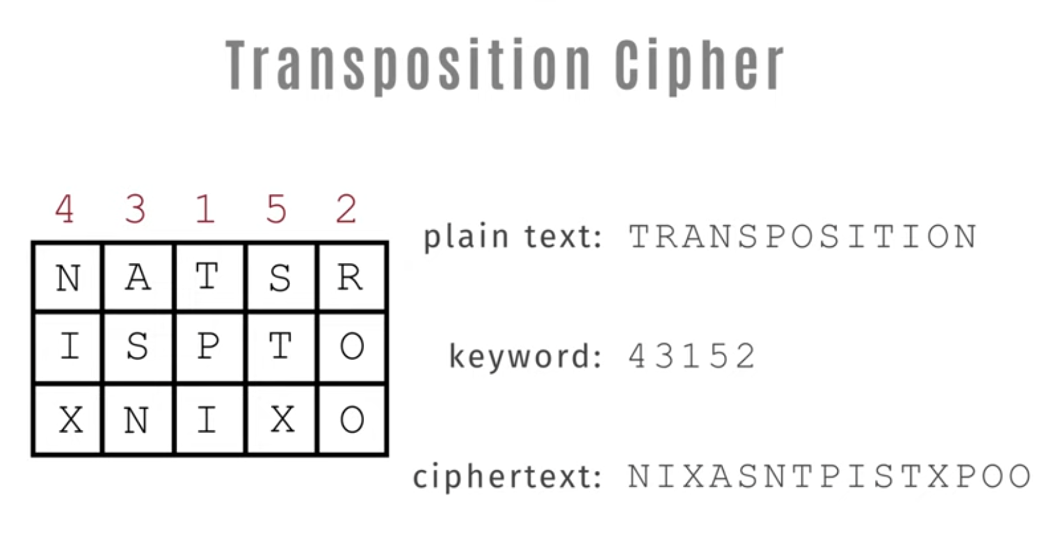
Transposition Ciphers

Slide 40
Product Ciphers
Ciphers using substitutions or transpositions are not secure because of language issues
Consider several ciphers in succession to make harder, but:
  02 Substitutions make a more complex substitution
  02 Transpositions make more complex transposition
  But a substitution followed by a transposition makes a new much harder cipher
This is bridge from classical to Modern Ciphers
Notes:
Have seen that ciphers based on just substitutions or transpositions are not secure, and can be attacked because they do not sufficient obscure the underlying language structure
So consider using several ciphers in succession to make harder.
A substitution followed by a transposition is known as a Product Cipher, and makes a new much more secure cipher, and forms the bridge to modern ciphers.

Slide 41
Rotor Machines
Before modern ciphers, Rotor machine was used
Widely used in WW2
  German Enigma, Allied Hagelin, Japanese Purple
Implemented a very complex, substitution cipher
A series of cylinders, each giving 1 substitution, which rotated and changed after each letter is encrypted
With 3 cylinders have 26³=17576 alphabets
https://www.youtube.com/watch?v=TjaKCfSng-4
Notes:
The next major advance in ciphers required use of mechanical cipher machines which enabled to use of complex varying substitutions.
A rotor machine consists of a set of independently rotating cylinders through which electrical pulses can flow. Each cylinder has 26 input pins and 26 output pins, with internal wiring that connects each input pin to a unique output pin. If we associate each input and output pin with a letter of the alphabet, then a single cylinder defines a monoalphabetic substitution. After each input key is depressed, the cylinder rotates one position, so that the internal connections are shifted accordingly. The power of the rotor machine is in the use of multiple cylinders, in which the output pins of one cylinder are connected to the input pins of the next, and with the cylinders rotating like an “odometer”, leading to a very large number of substitution alphabets being used, eg with 3 cylinders have 26³=17576 alphabets used.
They were extensively used in world war 2, and the history of their use and analysis is one of the great stories from WW2.

Slide 42

Hagelin Rotor Machine
Notes:
This photo of an Allied Hagelin machine was taken by Lawrie Brown at Eurocrypt'93 in Norway. Note pen for scale, and the rotating cipher wheels near the front.

Slide 43
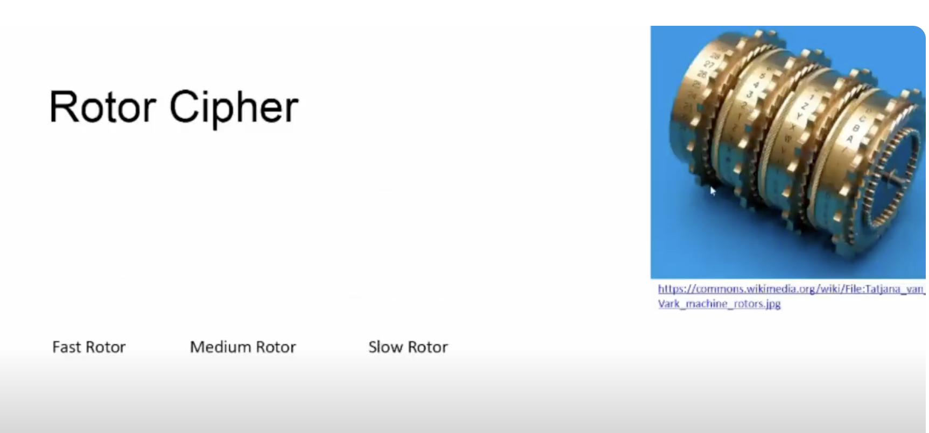

Slide 44
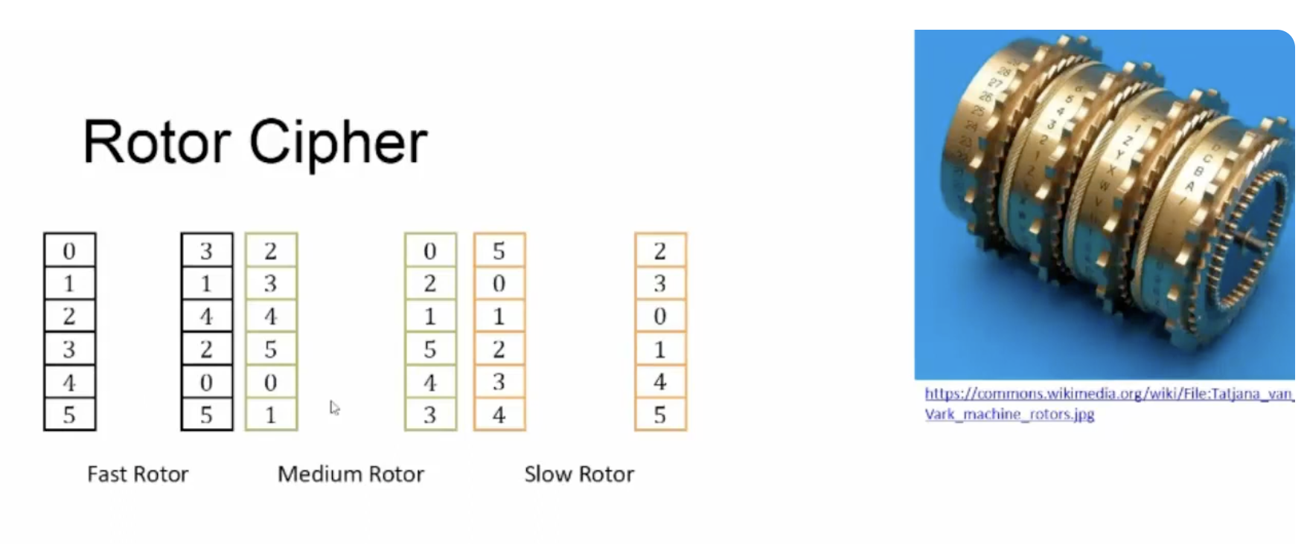

Slide 45
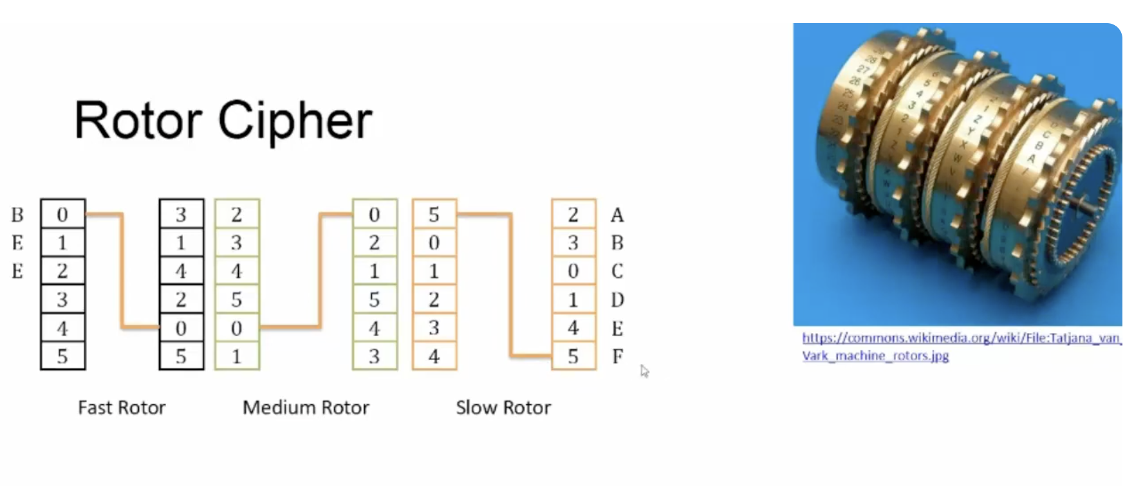

Slide 46
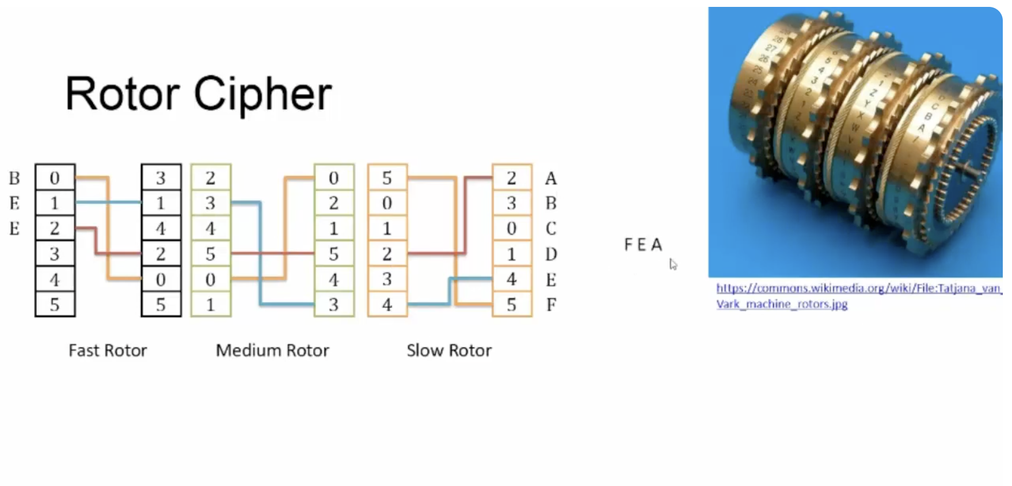

Slide 47
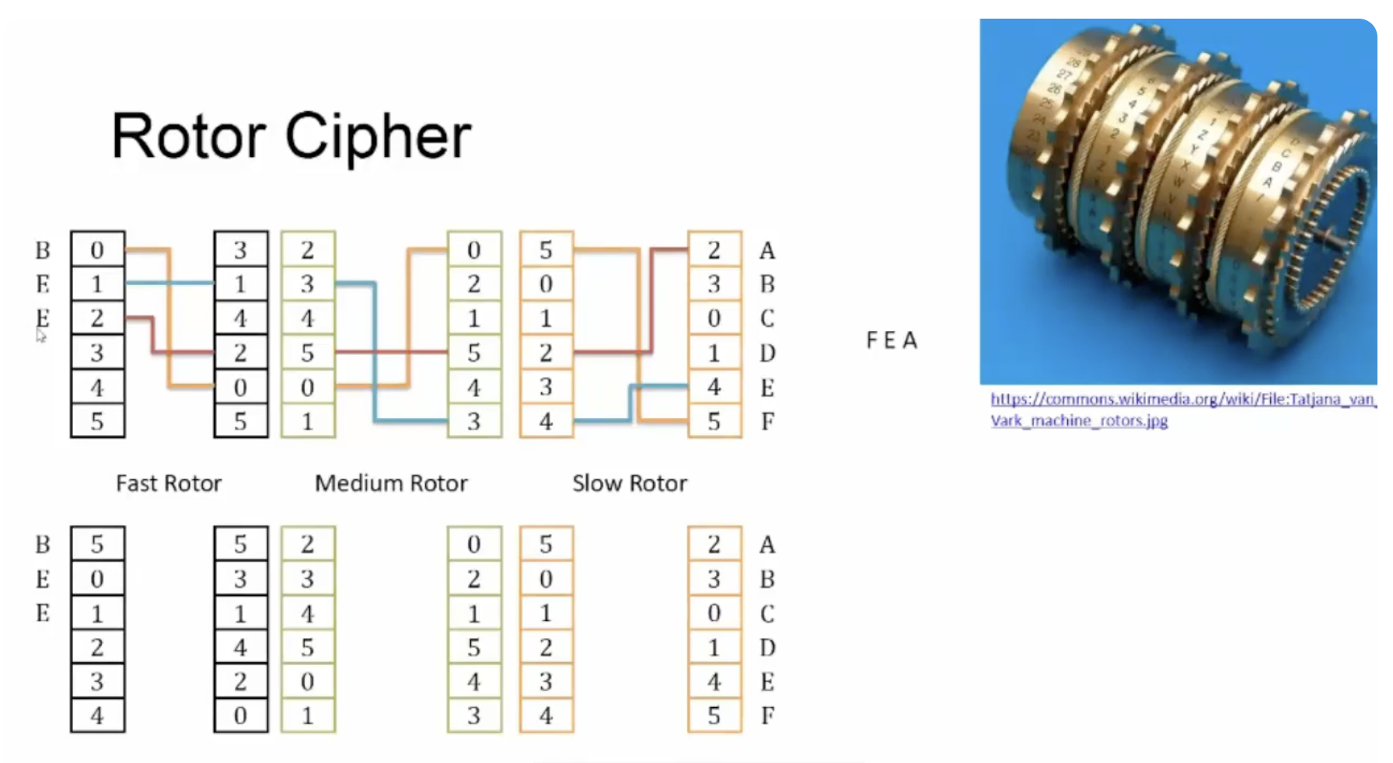

Slide 48
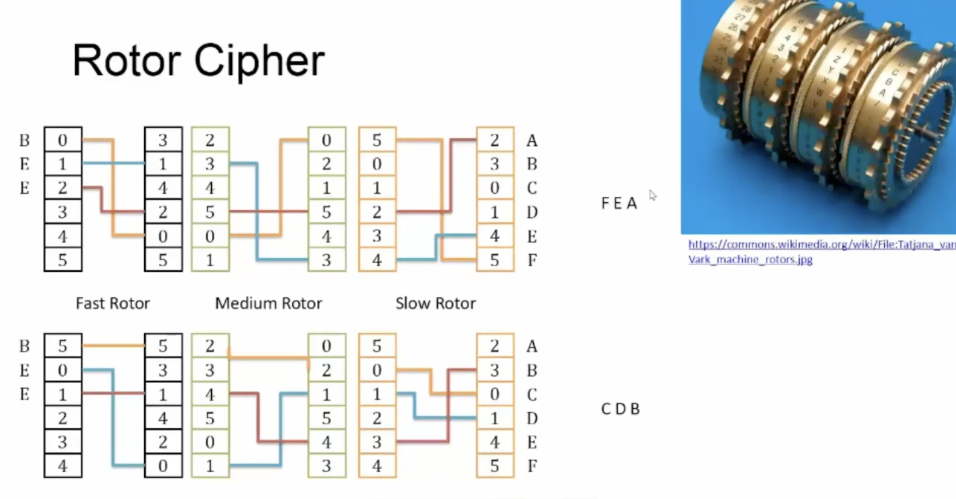

Slide 49
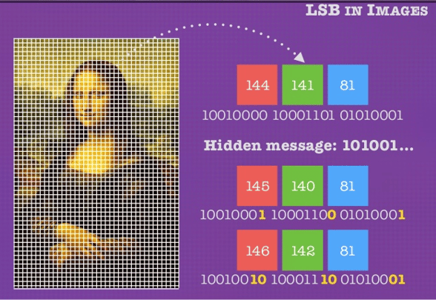
Steganography
Alternative to Encryption
Hiding a message within something that isn't a secret.
Using only a subset of letters
  using invisible ink
  hiding in LSB in graphic image
High overhead to hide relatively few info bits
  https://www.youtube.com/watch?v=_8wAUdKF9Yk
Notes:
Steganography is an alternative to encryption which hides the very existence of a message by some means. There are a large range of techniques for doing this.
Steganography has a number of drawbacks when compared to encryption. It requires a lot of overhead to hide a relatively few bits of information.
Also, once the system is discovered, it becomes virtually worthless, although a message can be first encrypted and then hidden using steganography.

Slide 50
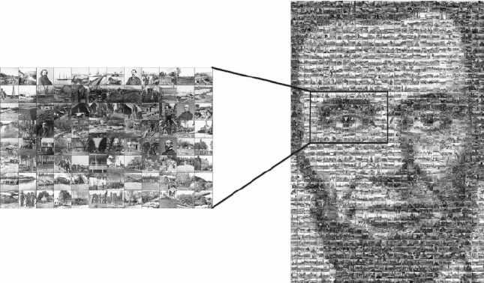
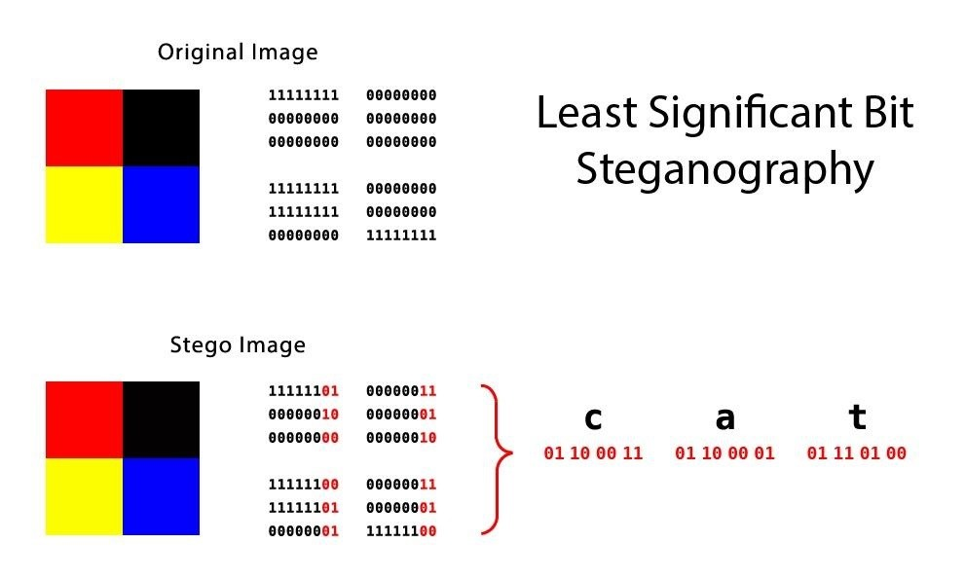
Steganography

Slide 51
Questions?
Home Work
Implement Vigenère Cipher
Notes:
Steganography is an alternative to encryption which hides the very existence of a message by some means. There are a large range of techniques for doing this.
Steganography has a number of drawbacks when compared to encryption. It requires a lot of overhead to hide a relatively few bits of information.
Also, once the system is discovered, it becomes virtually worthless, although a message can be first encrypted and then hidden using steganography.

